Slide 1

Python Course Chapter 6
Object-Oriented Programming

Slide 2
Object-Oriented Programming
Object-oriented programming (OOP) is a method of structuring a program by bundling related properties and behaviors into individual objects. Just like many other programming languages, Python has OOP features as well. There are many built-in classes in Python, and we can create our own types as well.
A class is a code template for creating objects. Objects have properties and have behavior associated with them. Basically, we can consider ”class” as a new data type that we can create on our own, just like the built-in Python number, string, set, list, dictionary, and many other data types.
*. The naming convention of class name is – always capitalize the first letter!

Slide 3
__init__() and Method
In an object-oriented approach, the __init__() method is the Python equivalent of the C++, Java, and JavaScript constructor. The __init__() function is called every time an object is created from a class. The __init__() method lets the class initialize the object's attributes and serves no other purpose. It is only used within classes.
A method is a function that “belongs to” an object; the method's first parameter will be called self (by convention).In other programming languages, this word is called this.

Slide 4
Class Attribute, Static Method and Class Method
A class attribute is a Python variable that belongs to a class rather than a particular object. It is shared between all the objects of this class, and it is defined outside the constructor function (This is just like the static attribute in other programming languages.)
Class attribute belongs to the class so that we can get the attribute directly from the class itself. Class attributes can be accessed by either:
self.__class__.attribute (inside method definition)
objectname.attribute (outside method definition)
classname.attribute (try not to use this in method definition)
*. Inside a method, when referring to the class itself, try to use self.__class__ as much as possible. Avoid hard code the class name.

Slide 5
Class Attribute, Static Method and Class Method
Similarly, a static method is also a method that is bound to the class and not the object of the class; however, a static method doesn't need self to be its first parameter.
Python also has another method called the "class method," similar to the static method. However, when defining class method, we give cls (stands for class) as the method's first parameter.
What's the benefit of using the class method over the static method? Well, if we ever change the class name, then the hard-coded classname inside the function will not work anymore. We will have to manually change all the class name inside the methods' code if we hardcode class name.

Slide 6

Why?
Now, we want to talk about – why we use class attributes, static methods, and class methods? Well, it’s 100% okay if we don’t use them at all.
However, suppose we can put all these attributes and methods that are common and shared among all instances into the class. In that case, we can avoid having many of the same data or methods occupying slots of our physical memory.
(In shorts, this can save memory.)

Slide 7
Inheritance
Inheritance allows us to define a class that inherits all the methods and properties from another class. The parent class is the class being inherited from, also called the base class. The child class is the class that inherits from another class, also called the derived class.
The super() method returns a proxy object (temporary object of the superclass) that allows us to access methods of the base class.

Slide 8
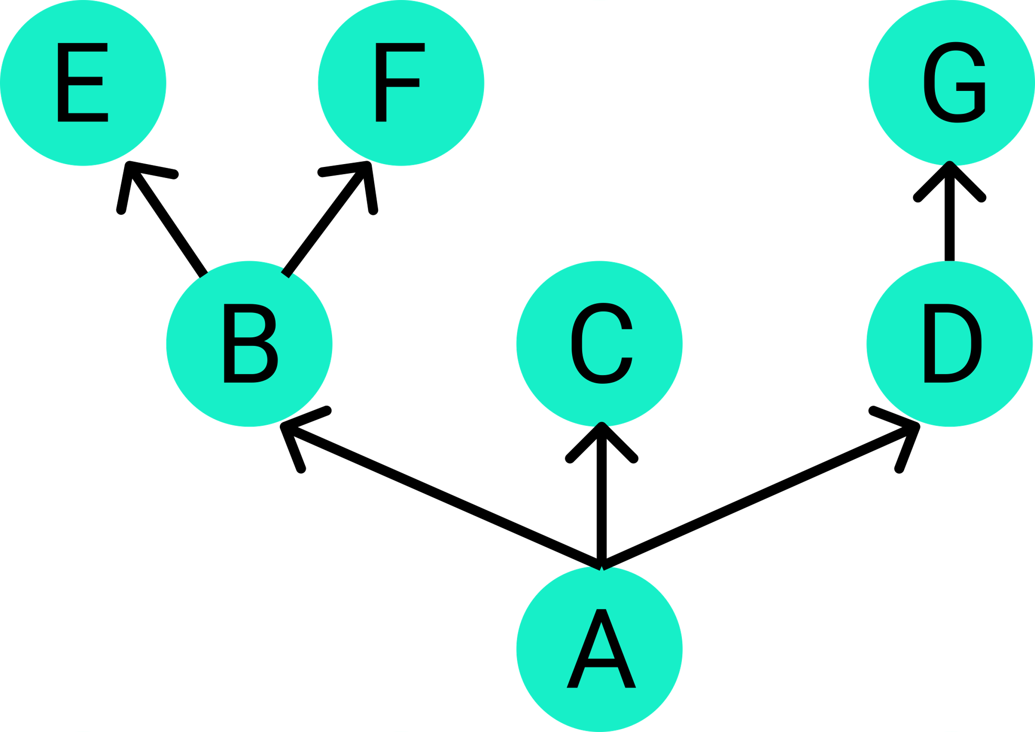
Multiple Inheritance
In Java and JavaScript, multiple inheritances are not allowed. In C++, multiple inheritances are permitted, but it’s incredibly complicated; people avoid using it as much as possible.
Python supports multiple inheritances!! This is not special. That just means we can inherit from more than one parent class.
Things become complicated if the inheritance graph is huge. For example, if we have:

Slide 9
Multiple Inheritance
The basic principle of method resolution order (MRO) uses a depth-first graph traversal algorithm. By applying the algorithm, we would get:
A, B, E, F, C, D, G
This is the order of where a method should be looked up.
If you cannot determine the MRO, we can use the Python built-in:
classname.mro()
classname.__mro__
To figure out the order.

Slide 10
Multiple Inheritance
Why do we use this kind of algorithm to do MRO? Well, the algorithm just makes sure that each class is visited once. However, this logic doesn’t make your code easier to read or maintain.
Some people insist that multiple inheritances are a bad idea. Many tasks can be done without multiple inheritances as well (such as Java).
However, we do get some benefits by using multiple inheritances – it allows us to avoid building profound inheritance relations.

Slide 11
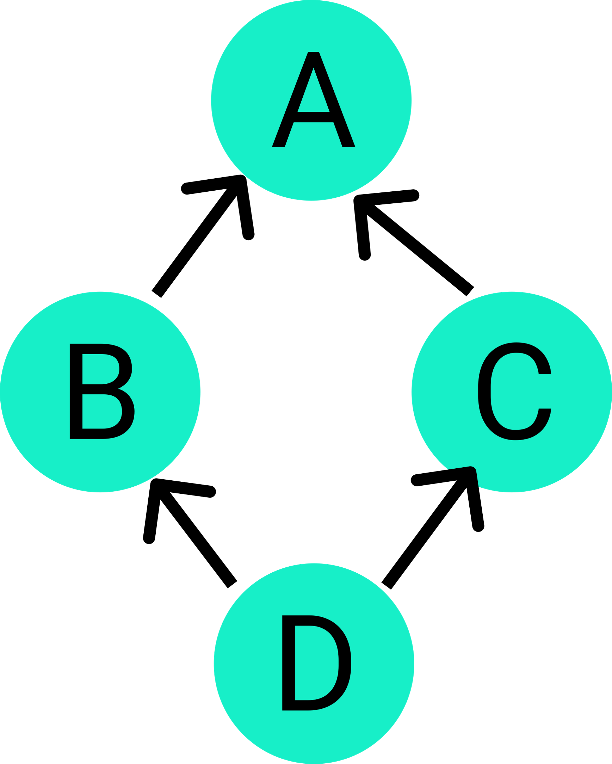
(Bonus Section) C3 Linearization
Traditionally, diamond problem occurs when we do multiple inheritance. Consider this:
By applying depth first traversal, we know that the method resolution order will be:
D, B, A, C, A

Slide 12
(Bonus Section) C3 Linearization
However, we are getting duplicate A in the order; it’s very intuitive that A comes before C. In the previous version of Python, MRO is in this order. Python 3 uses a new algorithm called the “C3 Linearization Algorithm.”
We won’t spend time learning what this is (since this is way out of the scope of our course); however, this C3 linearization does solve both problems; we don’t have duplicate A and C comes before A.
With C3 Linearization, the MRO of the diamond problem will be:
D, B, C, A
*. Read about C3 Linearization from https://en.wikipedia.org/wiki/C3_linearization if interested.

Slide 13

Private Attributes and Methods
In the context of class, private means the attributes or methods are only available for the class members, not for the outside of the class.
When defining private attributes and methods, we just need to add a double underscore at the front no underscore at the end; then, that attribute or method would become private.

Slide 14
Private Attributes and Methods
In Python, by convention, any attribute or method started with a single underscore is also private. This is not regulated by Python, which means they are still public. This is just a convention. (If we read the source code of Keras, then we can see this.)
However, even though we can access the attribute directly, we should still consider it as a private variable; try not to access it as much as possible.

Slide 15
(Bonus Section) OOP Style in Python
Traditionally, OOP design emphasizes information hiding; this is known as “encapsulation.” All attributes of an object should be as private as possible. The purpose of encapsulation is to prevent changing attributes of an object as that might cause an unexpected error.
When we really have to access attributes of an object, we usually define public methods called getter and setter. Traditionally, getters and setters access attributes and do some middleware work, such as changing units or checking the max and min value.
However, in Python, getter and setter are not considered Pythonic!!

Slide 16
(Bonus Section) OOP Style in Python
Then, we might have a question – how do we prevent outsiders from randomly accessing and changing the inner attributes of objects? In the Python community, a famous saying is, “We are all consenting adults.” That means we trust each other; if someone wants to make chaos, they have to be responsible for their decision.
That’s why we see both single and double underscore can be used for private attributes.
The difference between Python OOP and traditional OOP highlights the concepts of Python and other programming languages. Traditional OOP emphasizes error prevention and information hiding; on the other hand, Python focuses on readability.

Slide 17
@property decorator
Sometimes, when we are accessing or assigning an attribute of an object, we don’t want to access or assign it directly. For example,
When we have to change the unit from Celsius to Fahrenheit.
When we need to check if the value assignment is within a certain range.
Traditionally, this is done by getters and setters in other programming languages.
@property decorator is a built-in decorator in Python, which is helpful in defining virtual properties effortlessly.

Slide 18
The Mighty Hash Function
A hash is a function that converts one value to another. In Python, there’s a built-in hash() function. For example, we can do:
hash(“How are you doing today?”)
Then it will return 6941904779894686356. (some kind of integer)
Or, we can do:
hash(“hello”)
Then it will return 8027212646858338501. (another integer)
In Python, the hash function basically returns a fixed-sized integer.

Slide 19
The Mighty Hash Function
What can be hashed in Python? The Python hashable data types are integers, float, string, boolean, tuple, and None. All elements in the tuple need to be hashable so that the tuple can be hashable.
Most of Python's immutable built-in objects are hashable; mutable containers (such as lists or dictionaries) are not; immutable containers (such as tuples) are only hashable if their elements are hashable. Objects which are instances of user-defined classes are hashable by default. (But we can define the hash value by implementing the __hash__() method.)
The following data types are not hashable: set, list, dictionary.

Slide 20

The Mighty Hash Function
The two ideas, hashable and immutable, are related because objects which are used as hash keys must typically be immutable, so their hash value doesn't change.
If it were allowed to change, then the location of that object in a data structure such as a hashtable would change, and then the whole purpose of hashing for efficiency is defeated.

Slide 21
The Mighty Hash Function
Here are some key features of a good hash function:
Consistent – each time we give the same input to the hash() function, we need to get the same output.
Distributed Evenly – a small change in input should result in a huge difference in output. This will reduce the number of hash collisions. (Hash collision means 2 different input gives the same output.)
Not invertible – this function should not be invertible for security purposes.
*. We won’t learn how to create our own hash function in this course. This is not the main focus here. If interested, you can learn more about hash function in algorithms and data structure class.

Slide 22
The Mighty Hash Function
Note that the hash of a value only needs to be the same for one run of Python. In Python 3.3, they will, in fact, change for every new run of Python.
This is to make it harder to guess what hash value a particular string will have, which is an important security feature for web applications etc.
Hash values should therefore not be stored permanently. If we need to use hash values in a permanent way, we can take a look at the more "serious" types of hashes, cryptographic hash functions, such as bcrypt, SHA-256, RSA algorithm, Elliptic Curve Cryptography.

Slide 23
The Mighty Hash Function
The idea of hash function is widely used in the real world. For example,
Passwords are hashed before they get stored in the database. By that, even someone hacks into the system, they cannot see the password. Also, they cannot do any reverse engineering since the hash function is not invertible.
Hashtable uses hash function. In Python, dictionary and set both implements hashtable. Therefore, when doing value look-up (by using the membership operator in) in dictionary and set, the speed is constantly fast regardless of the size of dictionary or set. (However, list look-up time depends on the size of the list. The bigger the list is, the longer it takes.)

Slide 24
__hash__() function
As we mentioned before, any object that implements the __hash__() function can be used as a key for dictionary.
An easy, correct way to implement __hash__() is to use a key tuple. We can just return the hashed value of the key.
Also, Python automatically calls the __eq__() method of a class when you use the == operator to compare the instances of the class. Therefore, in our class, we should implement this __eq__() method by:
Check if the type matches
Check if the key() matches

Slide 25
Dunder or Magic Methods
Dunder or magic methods in Python are the methods having two prefixes and suffix underscores in the method name. Dunder here means “Double Under (Underscores)”. These are commonly used for operator overloading.
Besides the __init__, __eq__, __hash__ we learned, the following list is some dunder methods we can implement in Python classes:

Slide 26
Dunder or Magic Methods
__str__() is used for creating output for end user while __repr__() is mainly used for debugging and development. __repr__() goal is to be unambiguous and __str__() is to be readable.
The python built-in print method looks for the string method of the object.
__len__
__str __ (user-readable string)
__repr __ (stands for representation)
__add __
__gt__ (great than)
__ge __ (great than or equal to)
__lt __ (less than)
__le __ (less than or equal to)

